Slide 1
Mughals

Slide 2
Early History
Mongols that had moved to India
Loose Turkish Empire
Known as Delhi Sultanate

Slide 3
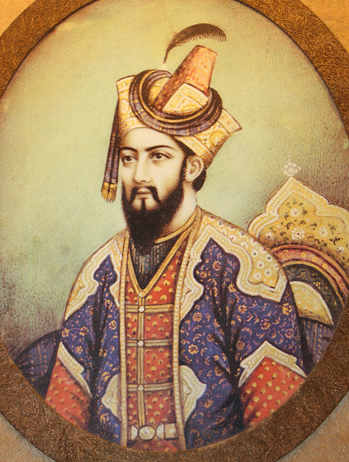
Babur
Set foundation for Mughals
Brilliant general
His son lost most of empire

Slide 4
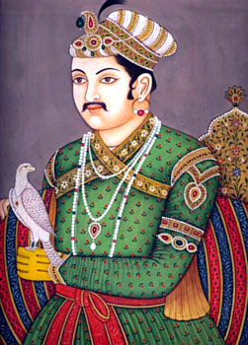
Akbar’s Golden Age
Akbar “Greatest One”
Military power is root of strength
Cultural blending
Firm believer in religious tolerance
Graduated income tax

Slide 5
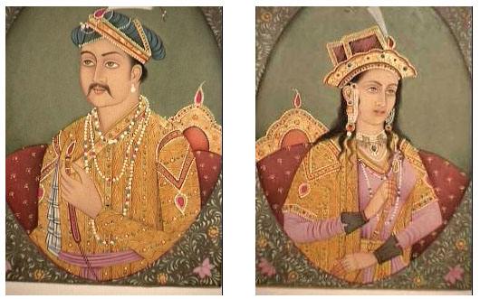
Akbar’s Religious Tolerance
Married women of different faiths
Got rid of taxes based on religion
Anyone could hold high political office

Slide 6
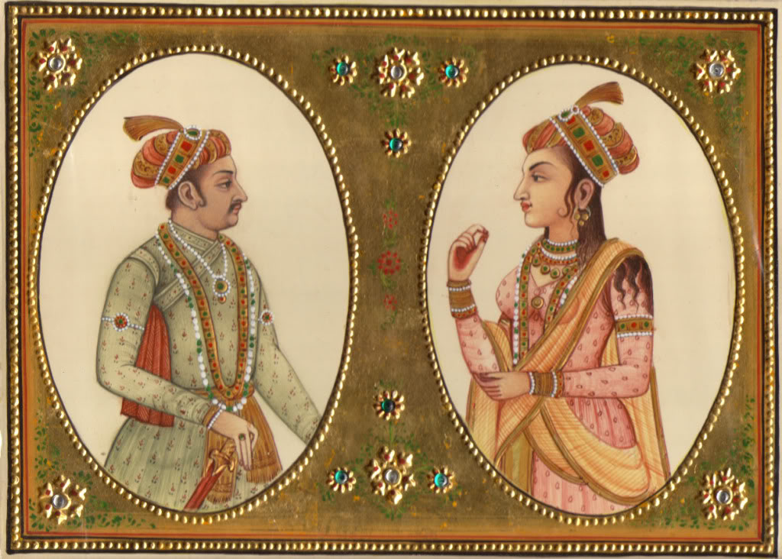
After Akbar
Jahangir “Grasper of the World”
Allowed his wife to rule through him
Nur Jahan – Persian Princess
Beginnings of religious conflict
Promoted Islam
His exiled son rebelled

Slide 7
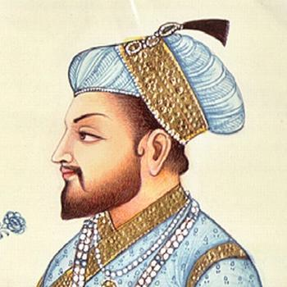
Shah Jahan
Son of Jahangir
India suffered from famine
Built Taj Mahal for wife

Slide 8
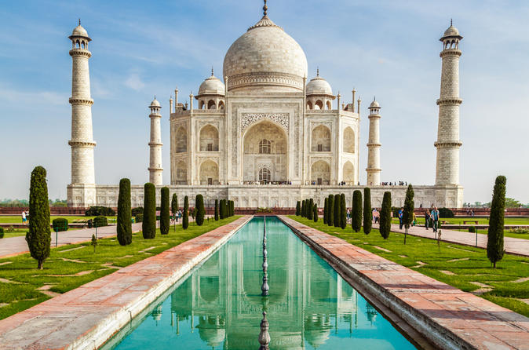

Slide 9
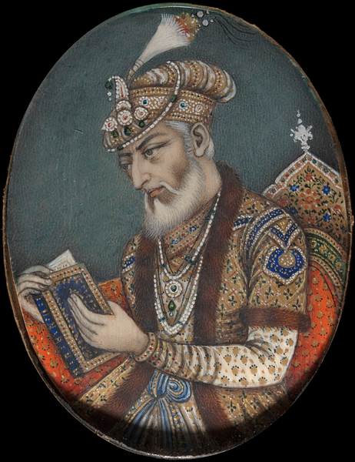
Jahan’s Son
Aurangzeb
Oppressive ruler
Rigidly enforced Islamic law
Policed subjects’ morals
Brought back tax on non-Muslims

Slide 10
Empire’s Decline
Aurangzeb drained empire’s resources
Power of central state decreased
Influx of European traders

Slide 11
Buddhism!

Slide 12
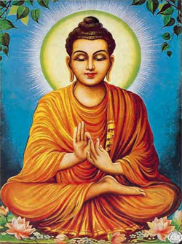
Spread of Buddhism
Missionaries spread Buddhism faith over Asia
Sri Lanka & SE Asia
Never took hold in India
Traveled along trade routes to China

