Slide 1
Northern Renaissance

Slide 2
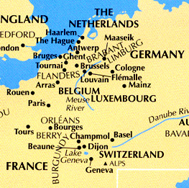
Where?
Germany
France
England
Flanders (Netherlands)

Slide 3
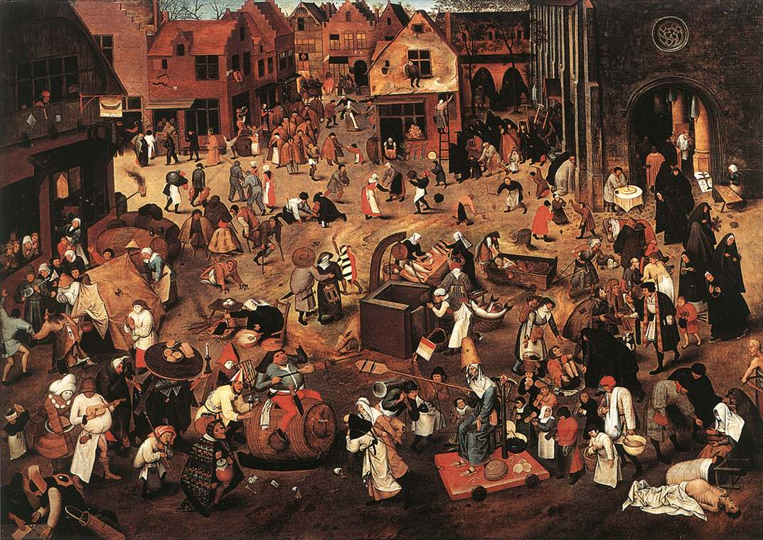
Beginnings of Northern Renaissance
1450 – Populations in northern Europe growing again
Cities growing rapidly following end of Hundred Years’ War
  1453
England & France unified under strong monarchies

Slide 4
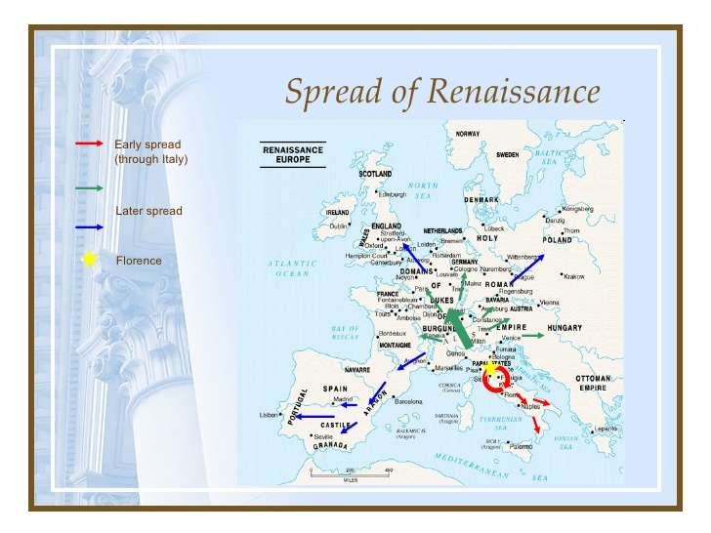
Spread of Renaissance Ideas
War pushes artists out of Italy (1494)
Northern artists go to Italy for school before moving back North
Flanders
  First city to support growing interest in art
  Rich from long-distance trade & cloth industry

Slide 5
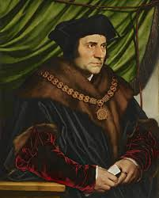
Northern Writers
Italians interested in Classical texts
Northern humanists examined traditional teaching of Church
  Became known as Christian Humanists

Slide 6
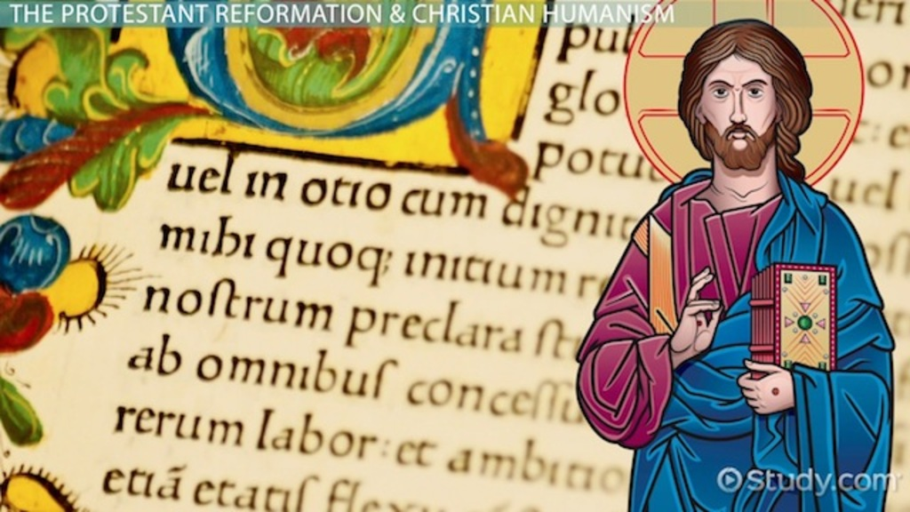
Christian Humanism
Ideal of human dignity inspired social reform based on Judeo-Christian values
Studied the early Christian sources
  Holy scripture
  Writings by Church fathers

Slide 7
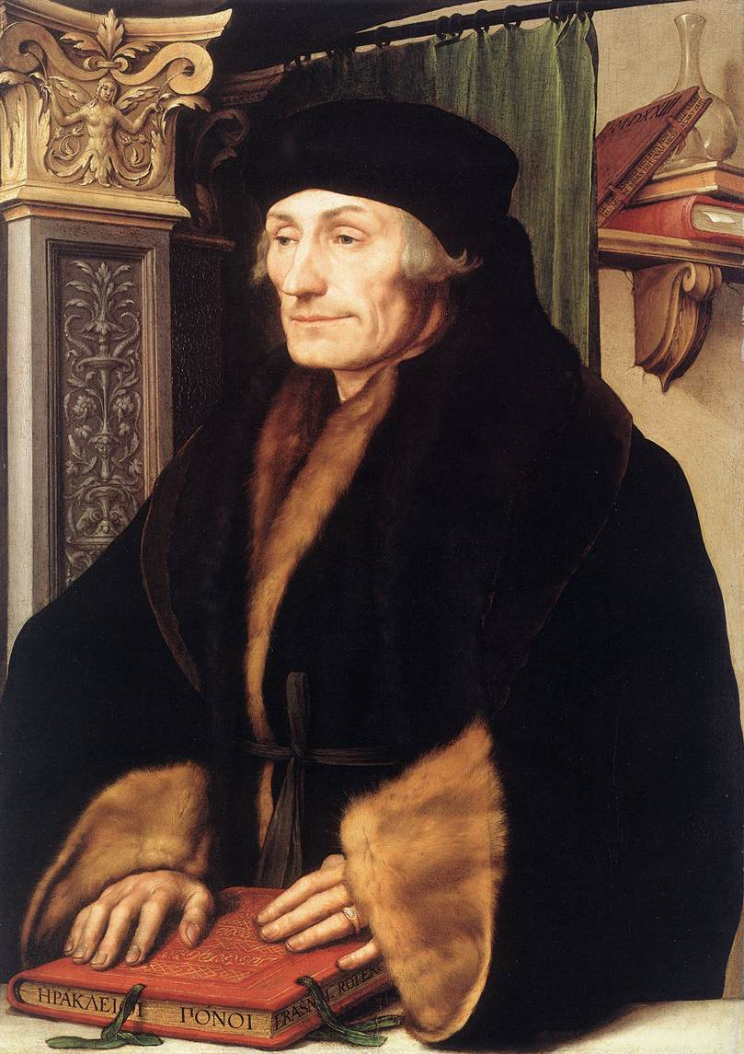
Christian Humanists
Had difficulty finding jobs at universities
  Due to focus on religion
  Became secretaries and advisors to Kings and Princes
    Ability to write and deliver orations made them useful

