Slide 1
Ottoman Empire Map Activity

Slide 2
Objective
Students will be able to track the expansion of the Ottoman empire by completing a map activity.

Slide 3
Ottoman Empire Map Questions
As you look at the maps, answer the following questions.
1. Where did the Ottoman Empire begin? Name the country.
2. When did the Ottoman Empire begin? How many years ago was that?
3. (a) What pattern do you notice in the maps over time? (b) What do you think caused this pattern?
4. Why do you think there are no more Ottoman Empire maps after 1920? In other words, what do you think happened to the empire?
5. How long did the Ottoman Empire last? Estimate the number of years.
6. Look at map of 1923. Which modern day country did the Ottoman Empire become?
7. (a) Look at the map of 1913. What modern-day countries did the Ottomans control then (hint: look up a map of the Middle East)?

Slide 4
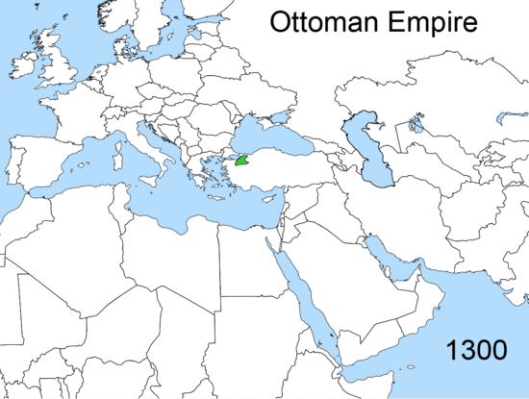
Istanbul

Slide 5
Istanbul

Slide 6
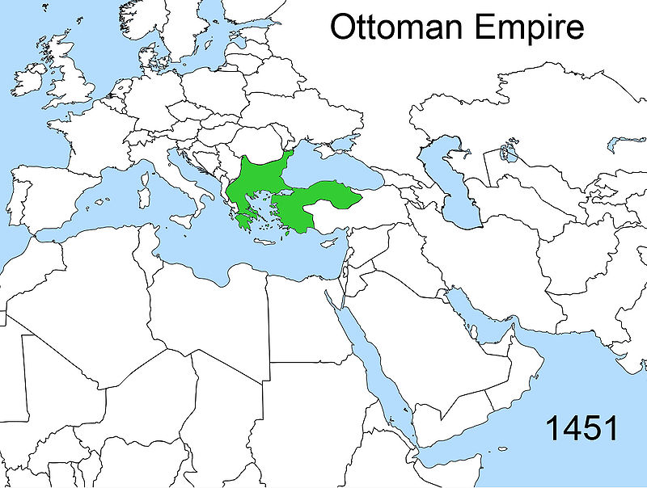
Istanbul

Slide 7
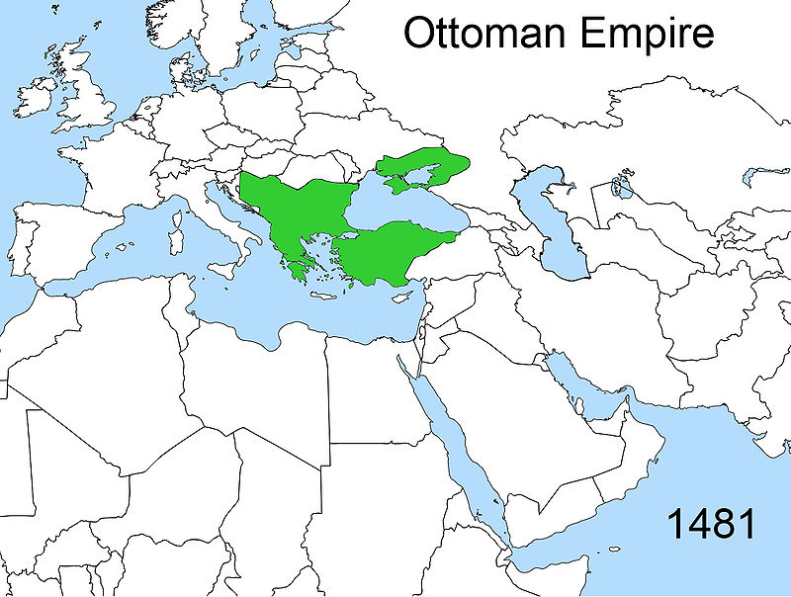
Istanbul

Slide 8
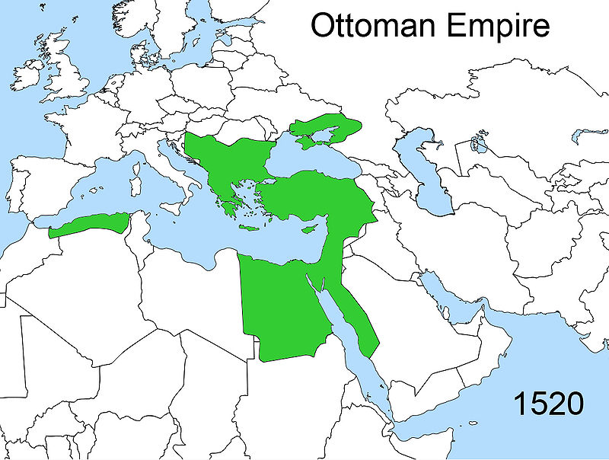
Istanbul

Slide 9
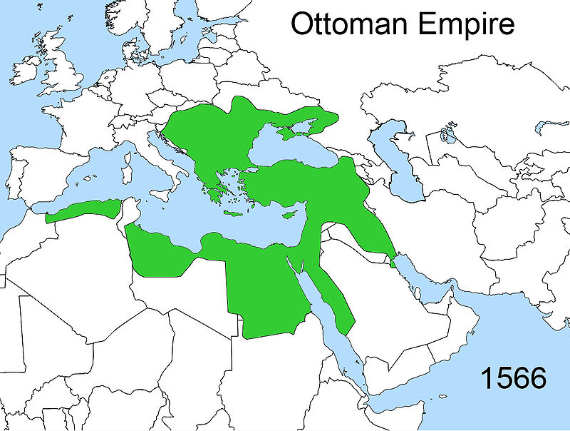
Istanbul

Slide 10
Istanbul

Slide 11
Istanbul

Slide 12
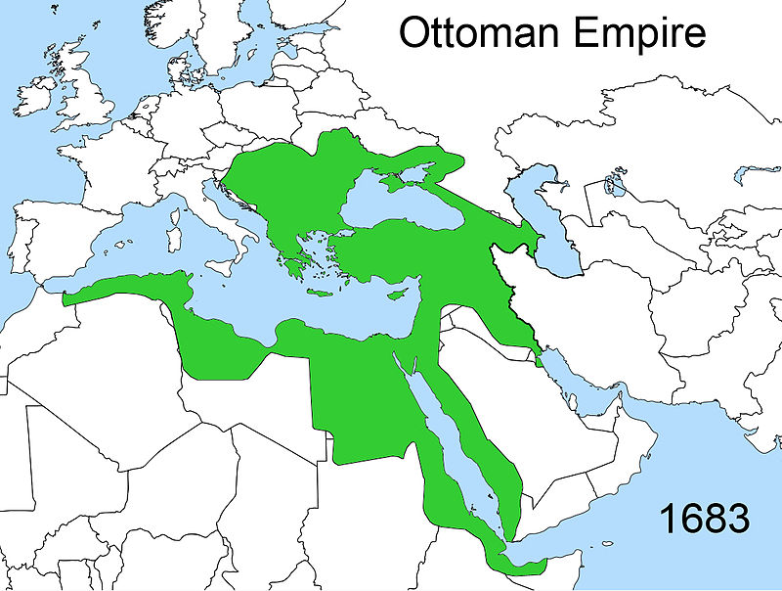
Istanbul

Slide 13
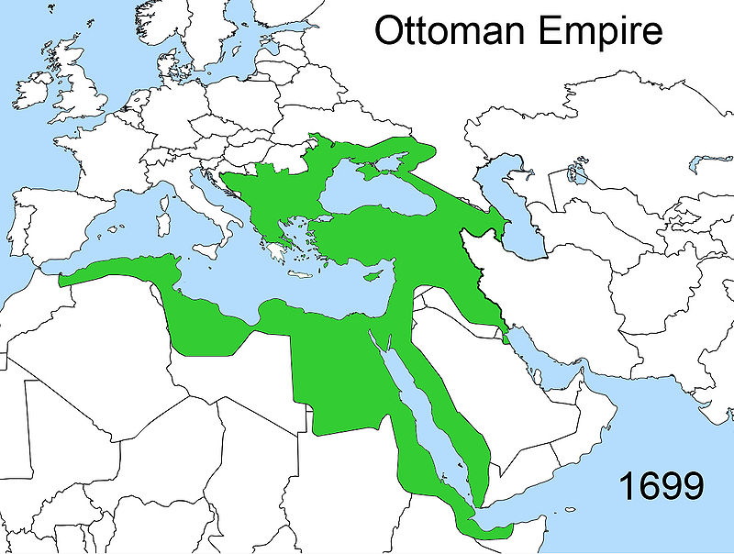
Istanbul

Slide 14
Istanbul

Slide 15
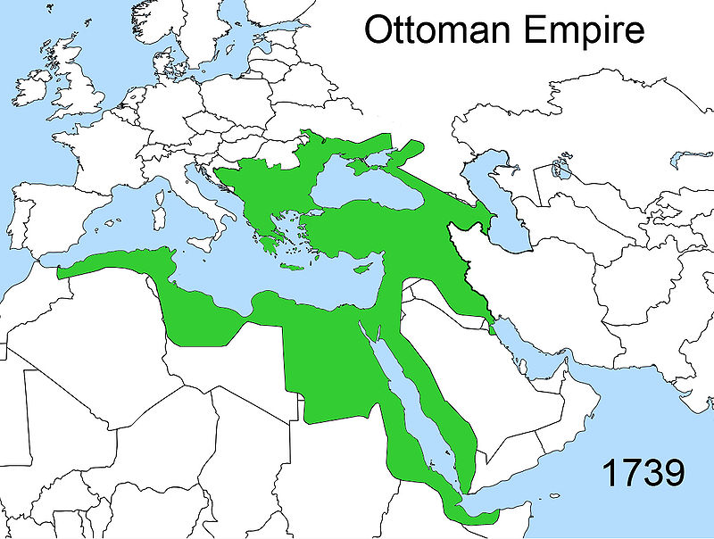
Istanbul

Slide 16
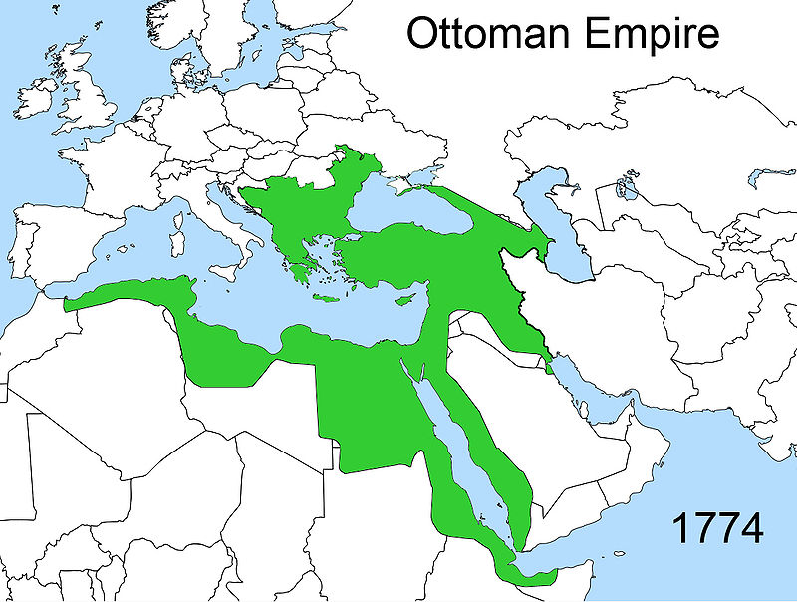
Istanbul

Slide 17
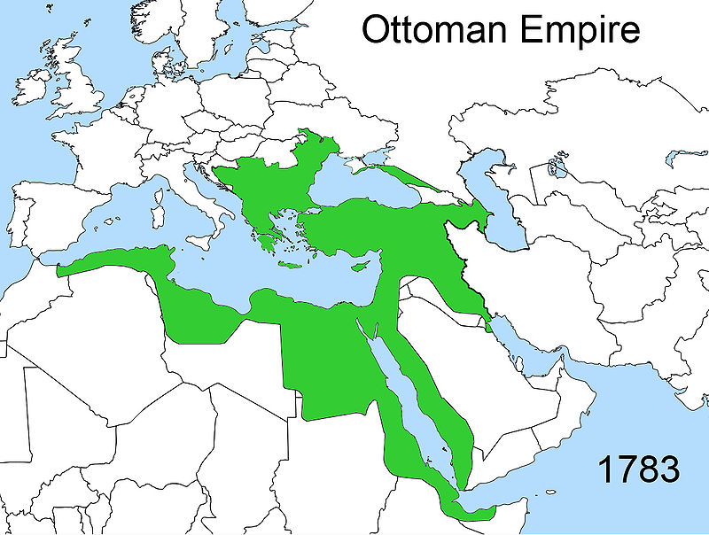
Istanbul

Slide 18
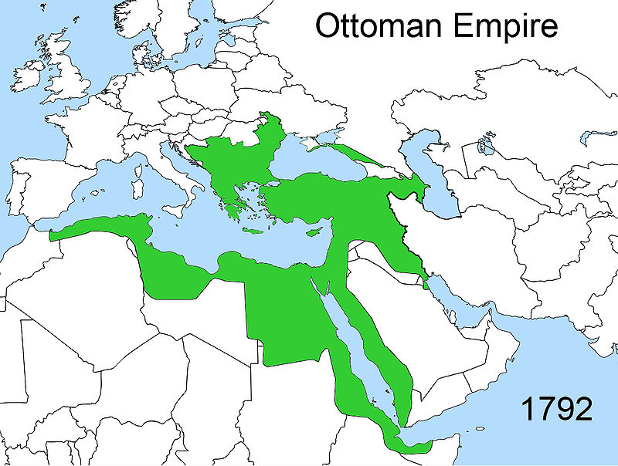
Istanbul

Slide 19
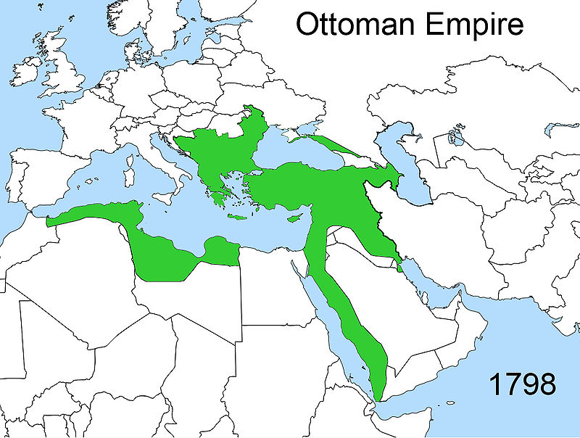
Istanbul

Slide 20
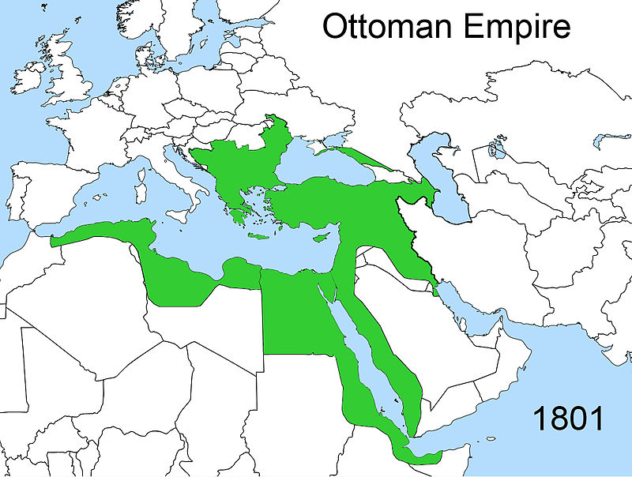
Istanbul

Slide 21
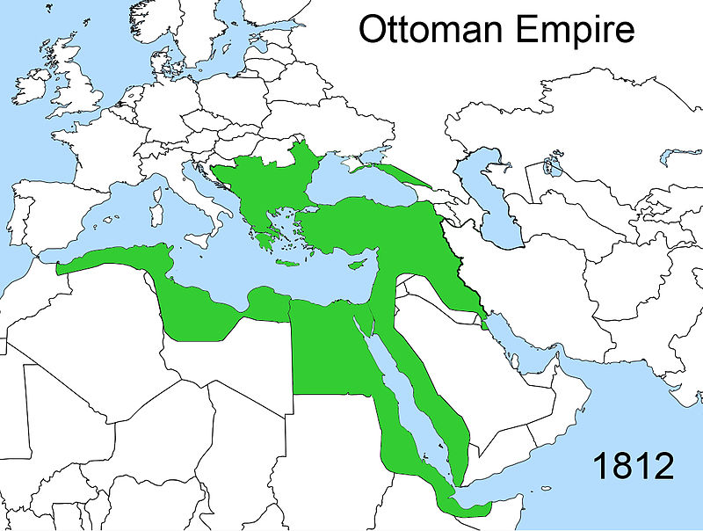
Istanbul

Slide 22
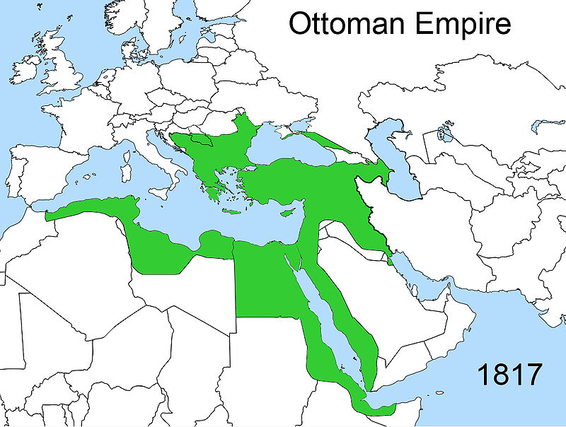
Istanbul

Slide 23
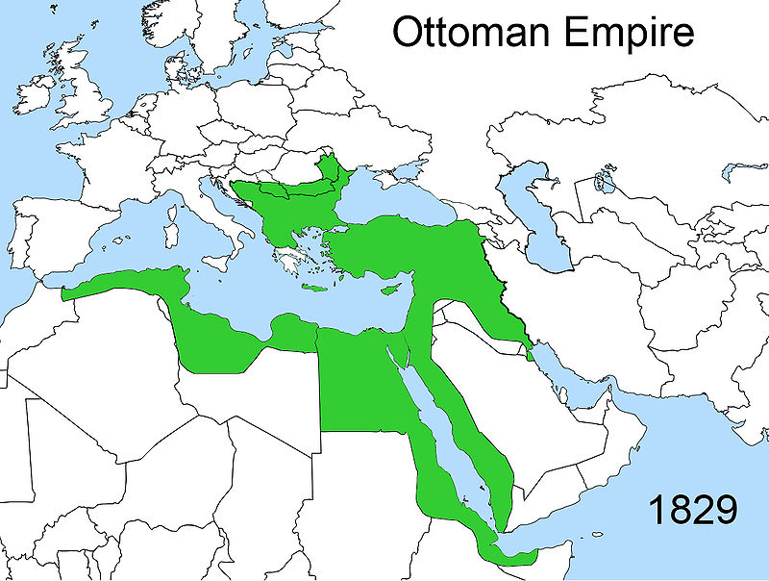
Istanbul

Slide 24
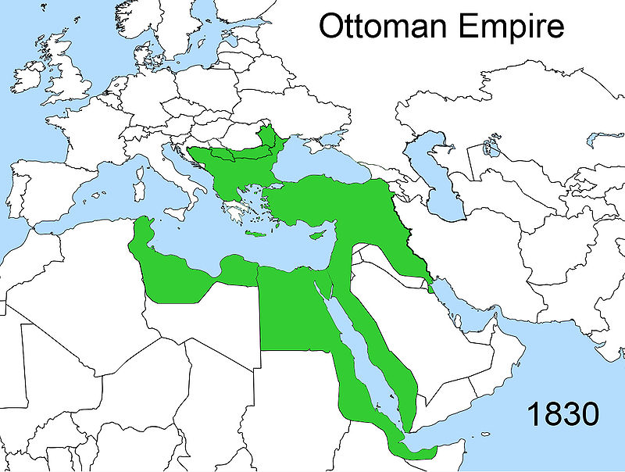
Istanbul

Slide 25
Istanbul

Slide 26
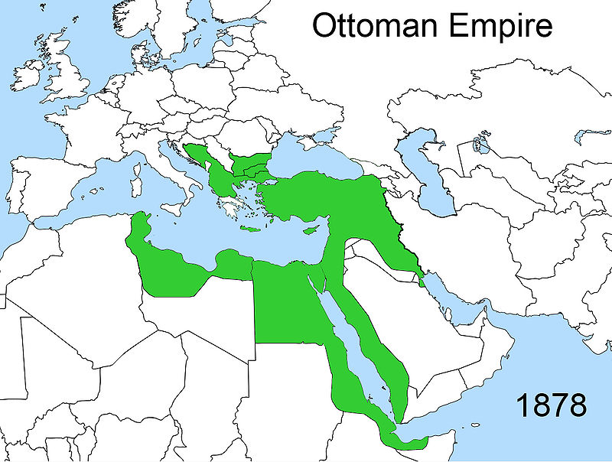
Istanbul

Slide 27
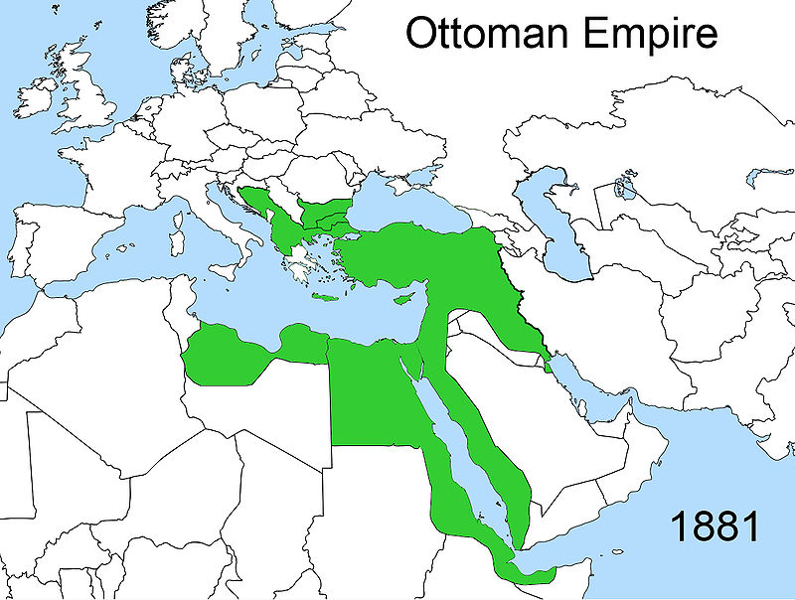
Istanbul

Slide 28
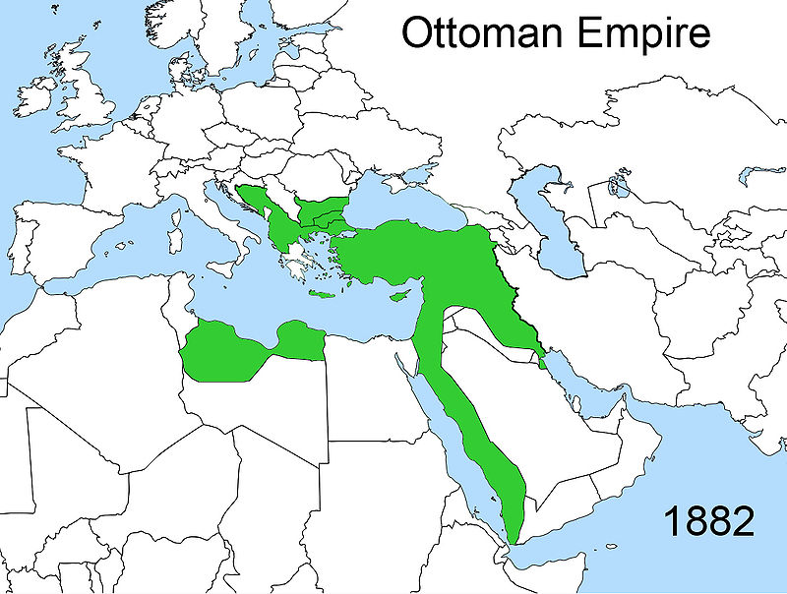
Istanbul

Slide 29
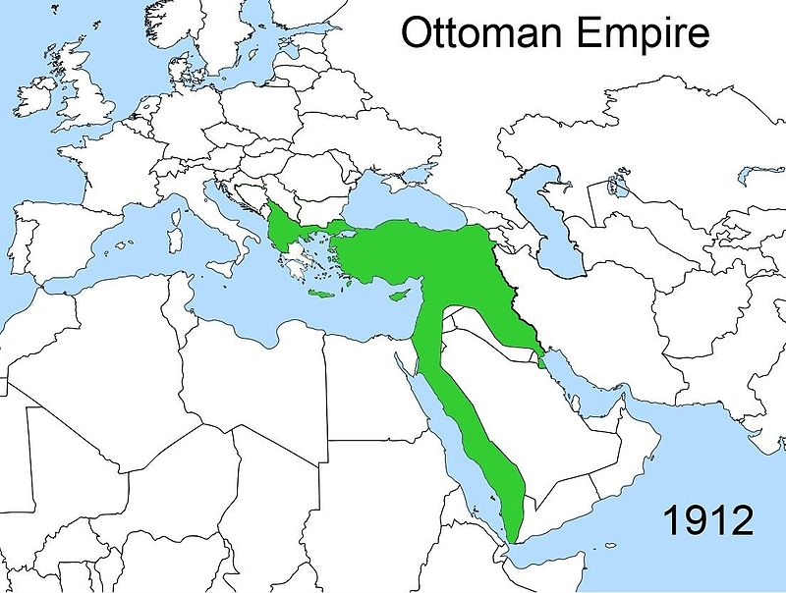
Istanbul

Slide 30
Istanbul

Slide 31
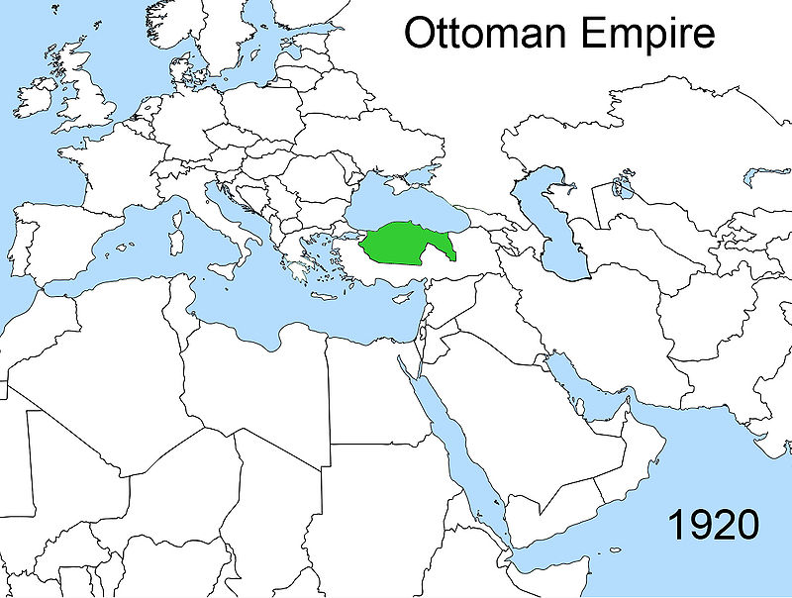
Istanbul

Slide 32
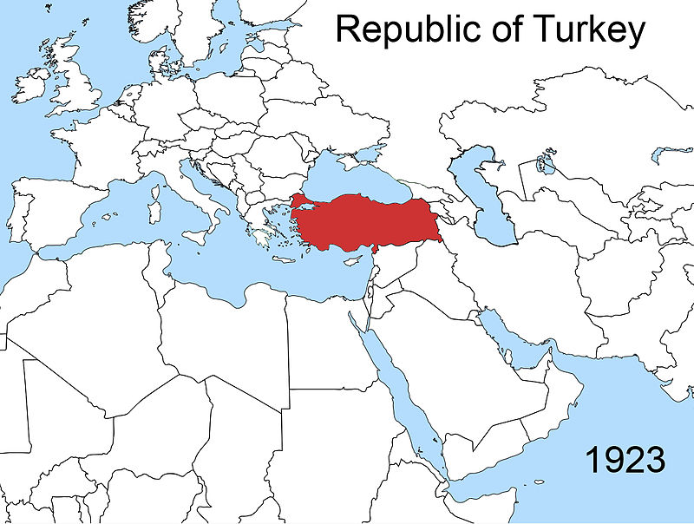
Istanbul

Slide 33
If you finish early, go to the next slide.

Slide 34
Click on the link and watch the video
https://www.youtube.com/watch?v=UN-II_jBzzo

