Slide 1
Protestant Reformation

Slide 2
Causes of Reformation
Secularism, Humanism, Individualism
Printing Press
  Spread of Ideas
Northern merchants resent paying taxes to Church

Slide 3
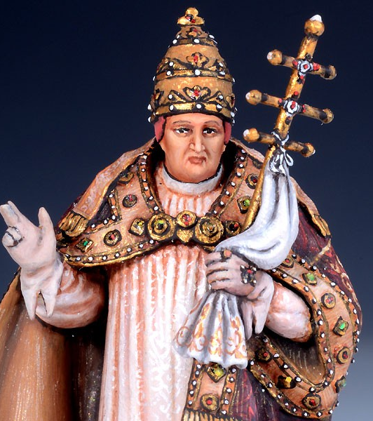
Criticisms of Catholic Church
Pope too concerned with worldly affairs
Uneducated lower clergy
Priests & monks broke vows

Slide 4
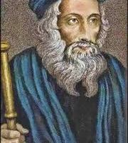
Early Reformers
John Wycliffe (England) & Jan Hus (Bohemia)
  Bible over Clergy
Christian Humanists
  Erasmus & More

Slide 5
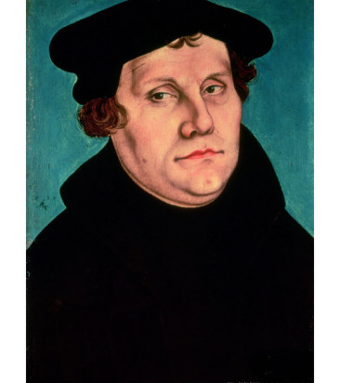
Martin Luther – Early Life
Born into a peasant family
Dad wanted him to be an attorney
Enrolled at University of Erfurt

Slide 6
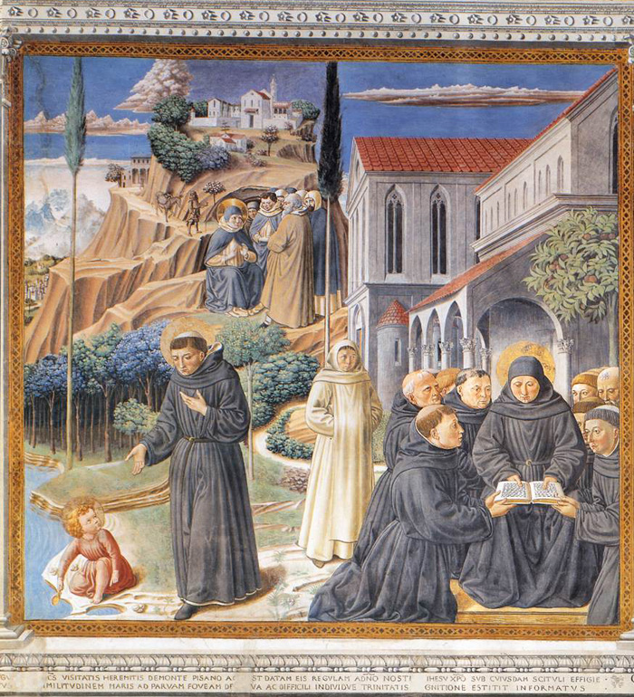
Defining Moment
Caught in a terrible storm
Promised God
  Save me and I’ll become a monk
Entered monastic order of Augustinian Hermits

Slide 7
Internal Struggle
Outwardly = rose to expectations
Inwardly = a soul in torment
Fasting & flagellants

Slide 8

His Path
Couldn’t convince himself that what God “wanted” was achievable
Poured over passaged describing the righteousness of God
Associated judgment with God’s Law

Slide 9
Luther’s Enlightenment
Romans 1:17
“The Just Shall Live By Faith”
Righteousness of God was a GIFT
  Could not be earned by good works
This saved Luther

Slide 10
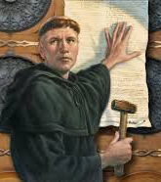
3 Tenants
Justification by Faith alone
Faith comes from knowledge & contemplation of the Bible
Equality in God’s eyes

Slide 11
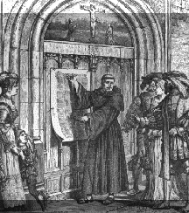
95 Theses
Public stand against a friar for selling indulgences
  Released sinners from penalties of their sins
Posted on Oct. 31, 1517, on the door of the castle in Wittenberg

Slide 12
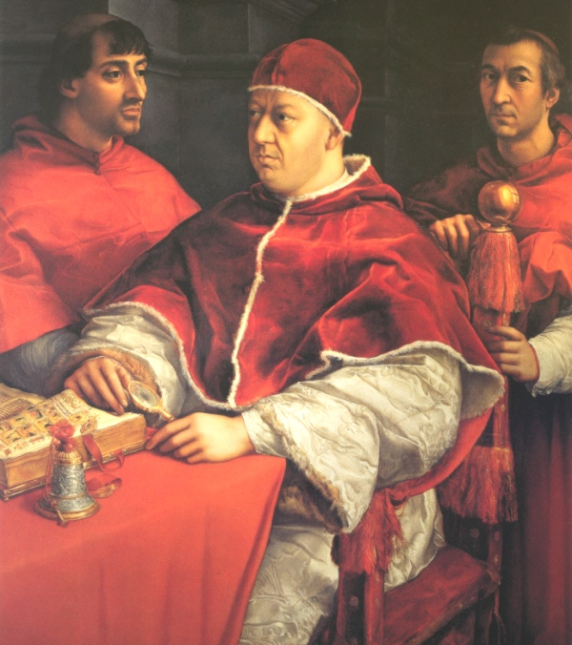
Leo X
Issued a decree that threatened to excommunicate Luther from the Church
Luther refused to recant his statements

Slide 13
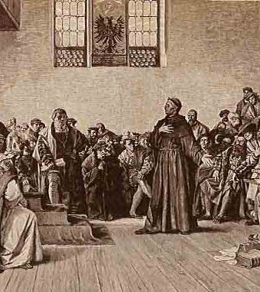
Edict of Worms
Charles V puts Luther on trial
Declares Luther an outlaw & heretic

Slide 14
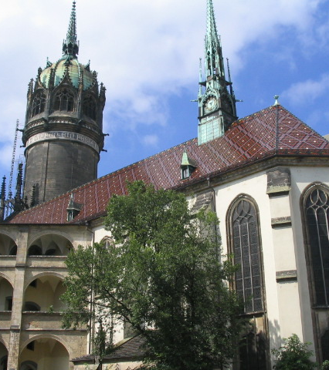
The Lutheran Church
1522
Returns to Wittenberg to begin practicing with the Lutheran Church

Slide 15
Peasant Revolts
Peasants applied Luther’s idea to social order
Began pillaging, raiding and burning the countryside
Luther was horrified

