Slide 1
The Italian Renaissance
A Cultural Revolution

Slide 2
Opening Question…
“Out of the thick Gothic night, our eyes were awakened to the glorious light of sun.” – François Rabelais
French humanist and author (c. 1494-1553)
What did Rabelais mean?
Why did he believe this?

Slide 3
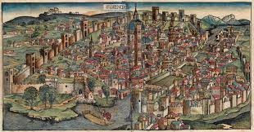
Late Middle Ages
Bubonic Plague
1/3 of the population dead
People began to question the Church
Loss of faith
People wanted to celebrate life and the human spirit

Slide 4
Why Italy?
Thriving City-States
A wealthy merchant class
More patronage
Classical heritage

Slide 5
Italian City-States
Crusades spur trade
Growth of large city-states in northern Italy
Cities = places where people exchange ideas
Plague disrupted economy
Few opportunities to expand causes businessmen to pursue other interests ➔ art

Slide 6
Question
How did the cities of Italy help create the Renaissance?
City life included wealth, leisure time, and exchange of ideas

Slide 7
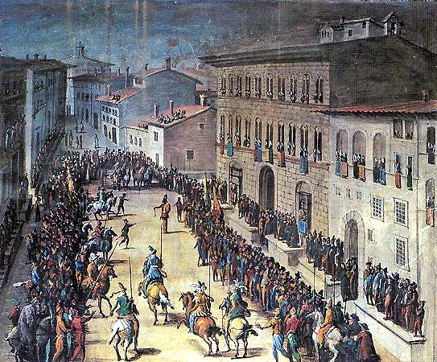
A Wealthy Merchant Class
Merchants
Dominated politics
Medici Family
Banking family
Controls Florence
Cosimo de Medici
Lorenzo de Medici

Slide 8
Classical Heritage
Artists and scholars study Greeks and Romans
Monasteries kept documents in tact
Christian scholars move to Rome following the fall of Constantinople in 1453

Slide 9
Humanism
Intellectual movement focused on human potential and achievements
Studied Classical texts to understand Greek and Roman values
Led to the idea of a secular society

Slide 10
Humanism
Focus on Liberal Arts
Grammar
Rhetoric
Poetry
History
Politics
Major Philosophy
Study of primary sources instead of received wisdom

Slide 11
Secularism
Wealthy enjoyed fine food, clothing, art, homes, music
Humanists suggested one could enjoy life without offending God

Slide 12
Renaissance Society
Three Estates
Clergy
Nobility – 3 %
Old rich (Middle Ages Lords)
New rich (capitalists and bankers)
Peasants – 90%
Middle burghers (small businesses & guilds)
The little people
Family Life
Arranged marriages
Dowries
Father-centered families

Slide 13
Renaissance Man
Excels in many fields
The classics, art, politics, combat
Baldassare’s The Courtier (1528)
Should be charming, witty, well educated in the classics; should dance, sing, play music, and write poetry; should be a skilled rider, wrestler, and swordsman)
Teaches how to become a “universal man”

Slide 14
Renaissance Woman
Upper-class, educated in classics, charming
Meant to inspire art but not create it
Women perhaps more oppressed, however many still ruled the home
Isabella d’Este
Born into ruling class Ferrera, Italy
Spoke Greek, Latin
Musician, dancer, patron of the arts
Home turned into an museum
Involved in politics

Slide 15
Revolution in Art
Artists use realistic styles copied from classical art
Portraits of individuals
Painters use perspective – a way to show three dimensions on a flat surface

Slide 16
Realistic Painting and Sculpture
Realistic portraits of prominent citizens
Sculpture shows natural postures and expressions
Biblical David is a favorite subject amongst sculptors

Slide 17
Changes in Literature
New Trends in Writing
Authors use vernacular
Self-expression or to portray individuality of their subjects

