Slide 1
Three Systems Emerge
Post Exploration and Colonization

Slide 4
Columbian Exchange

Slide 5
Mercantilism

Slide 6
Atlantic Slave Trade

Slide 8
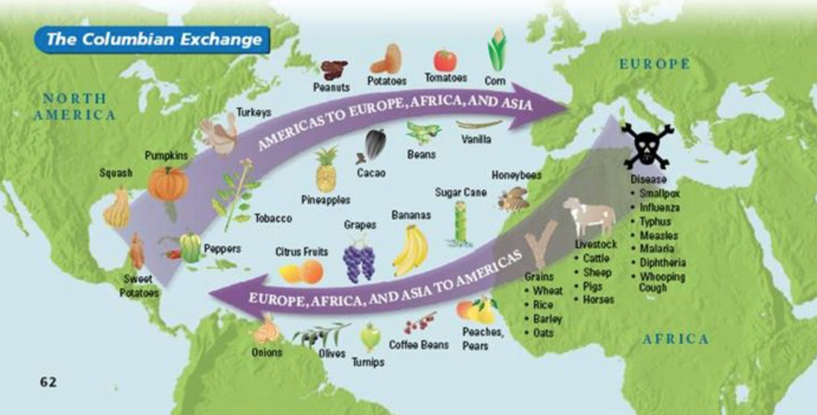
Columbian Exchange
Columbian Exchange:
Defined: an exchange of goods from the old world to the new world.
Logic: it started because of a need for new markets for goods and services.

Slide 9
Columbian Exchange
Mercantilism:
An economic policy under which nations sought to increase their wealth and power by obtaining large amounts of gold and silver by selling more goods than they bought.
Capitalism:
An economic system based on private ownership and the investment of money in business ventures in order to make profit.
Joint-Stock Company:
A business in which investors pool their wealth for a common purpose, then share their profits.
Joint-Stock Companies profits supplied the COLONIES at this point!

Slide 10
Columbian Exchange
Things Traded:
From US to Old World:
Tobacco, pumpkin, squash, sweet potato, pineapple, avocado, peppers, peanuts, potatoes, tomatoes, corn, beans, vanilla.
From Old World to US:
Grapes, turnips, onions, bananas, olives, peach, pears, coffee beans, honeybee, grains, cattle, sheep, horse, pig, DISEASE

Slide 11
Columbian Exchange
Good Things and Bad Things…
https://www.youtube.com/watch?v=HQPA5oNpfM4&list=PLIVgWCRdpBtdovU30jcaDbTfUtGKccTYY&index=2

